Slide 1
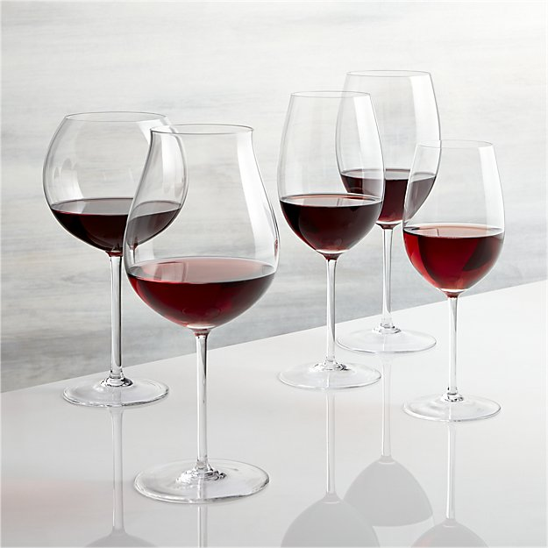
Wine Quality Prediction
May 2018
Becky Ling

Slide 2
Data Overview
Dataset: red Vinho Verde wine samples from the north of Portugal [Cortez et al., 2009]
Number of instances: 4,898
Number of Attributes: 12 1 - fixed acidity 2 - volatile acidity 3 - citric acid 4 - residual sugar 5 - chlorides 6 - free sulfur dioxide 7 - total sulfur dioxide 8 - density 9 - pH 10 - sulphates 11 - alcohol 12 - Output variable (based on sensory data): quality (score between 0 and 10)
Source: UCI Machine Learning Repository https://archive.ics.uci.edu/ml/datasets/wine+quality

Slide 3
Model Overview
Goal: Predict wine quality score using the 11 available attributes
Techniques Used:
Linear Regression
K-Nearest Neighbor
Decision Tree and Random Forest
Source: UCI Machine Learning Repository https://archive.ics.uci.edu/ml/datasets/wine+quality

Slide 4
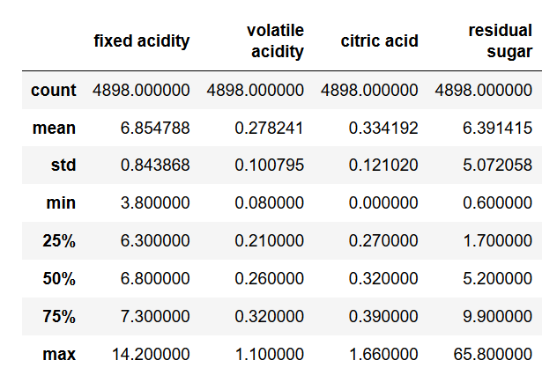
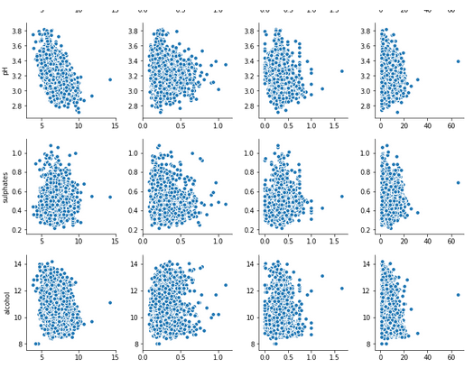
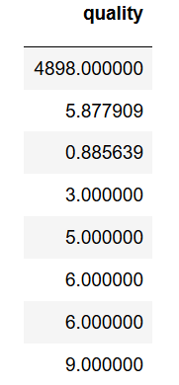
Exploratory Data Analysis
Summary statistics:
- No null values in the dataset
- Quality ranges between 3 - 9
2. Pair plot
- Outliers in residual sugar and density removed
- Other EDAs: CMAP, mean by quality

Slide 5
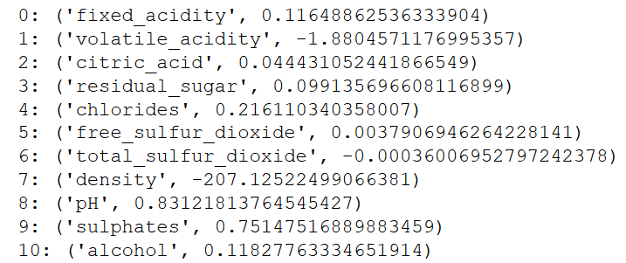
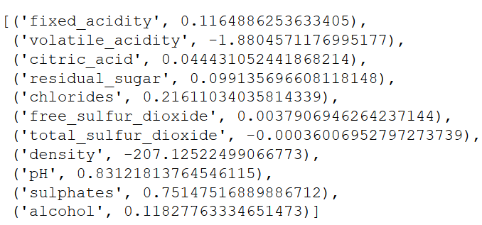
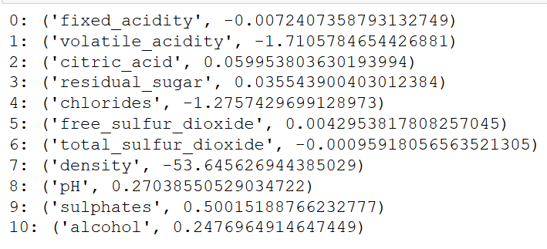
Linear Regression
Baseline null RMSE: 0.898
Linear regression without tuning:
RMSE: 0.77
Testing with different attributes may reduce RMSE, such as with alcohol, volatile acidity, and sulphates returned RMSE 0.74
Ridge Regularization
Alpha = 0, RMSE = 0.76:
Alpha = 0.1, RMSE = 0.77:
Density, chlorides, sulphates, and alcohol remain above 0 as alpha increases

Slide 6
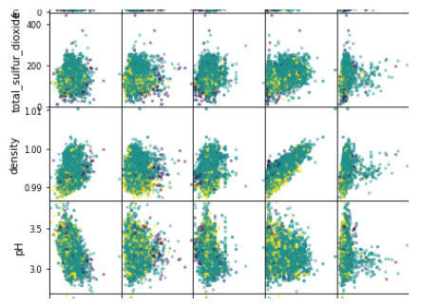
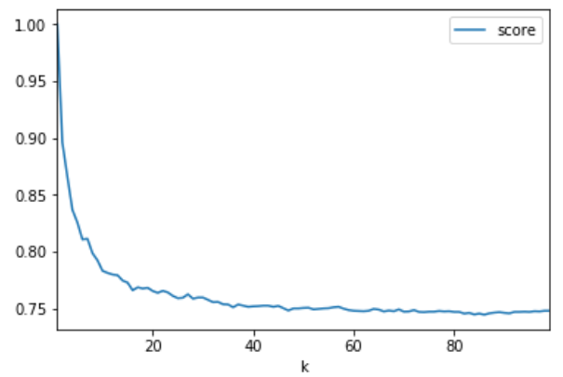
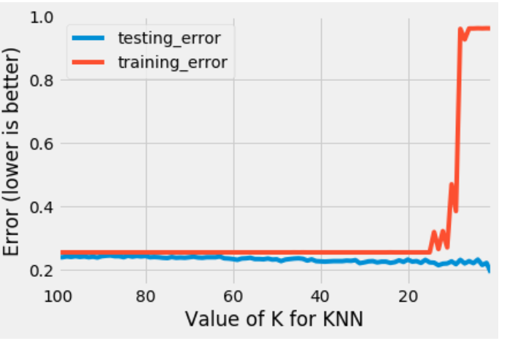
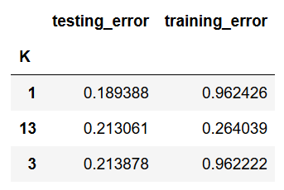
KNN Classification
Redistribute the quality into low (3-4), medium (5-6) , and high (7-9) scores since some scores have few observations
Standardize variables and find the optimal number of K that minimizes training and testing error between K = 1 to 100
Null accuracy is 0.75
While K = 1 returns the lowest testing error, training error is high. At K = 13, accuracy score is ~0.79
Score | Instances
3 | 20
4 | 163
5 | 1,457
6 | 2,197
7 | 880
8 | 175
9 | 5

Slide 7
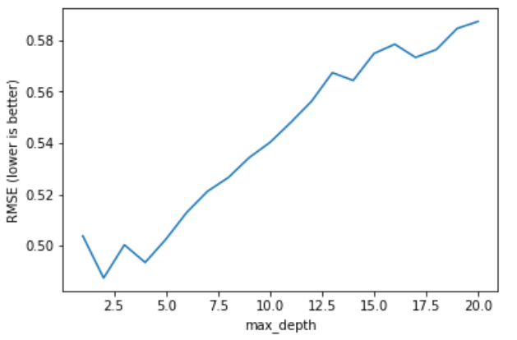
Decision Trees and Random Forest
Use all features and the quality score and apply classification tree regressor
Determine the maximum depth that minimizes RMSE, which is at 0.49
Using depth = 2, determine Gini importance of each feature. Highest is alcohol at 0.69
Random Forest:
Alcohol remains the most important feature, with a score of 0.14
Followed by volatile_acidity, density, and free_sulfur_dioxide
Accuracy score of 0.68
Using mean threshold, the max features to be considered at each split is 5
The average RMSE is 0.87
After reduction to the 2 most important features, the average RMSE became 0.81

